Slide 1
Details re SOCO shape file: Projection: Equidistant Conic Geographic Coordinate System: North American 1983 Linear unit: meters Origin: 40 deg N, -96 deg W

Slide 2
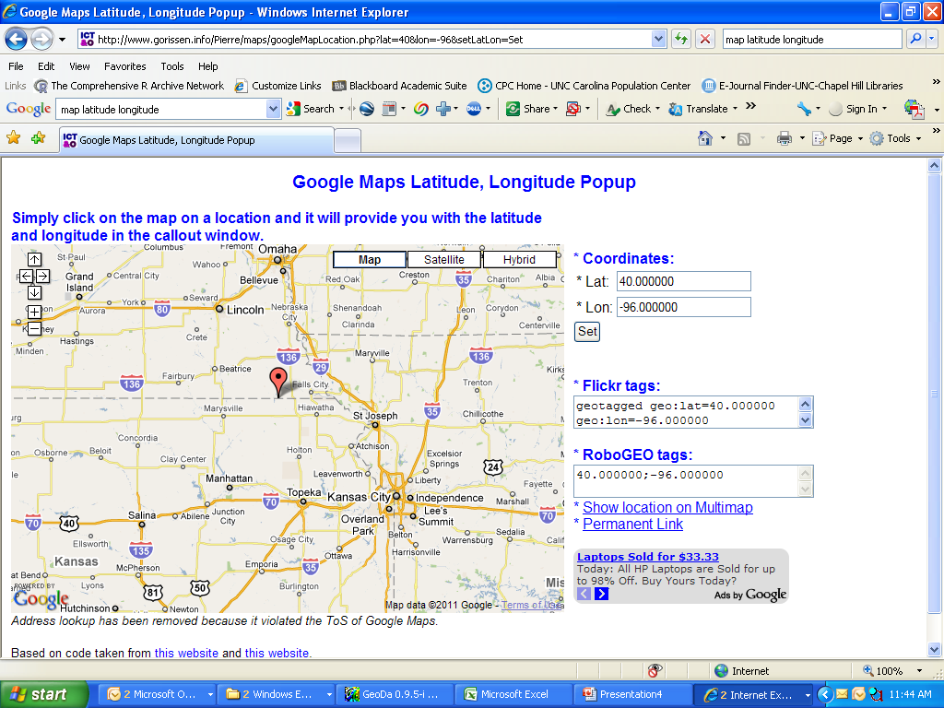

Slide 3
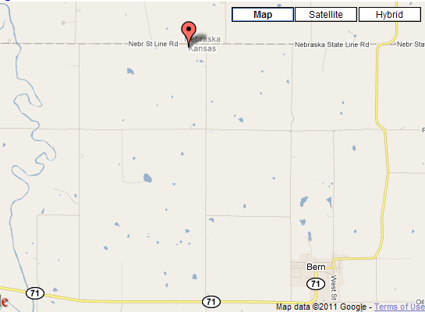

Slide 4
